Slide 1
Natural language processing
-By Asra

Slide 2
Natural language vs artificial language
Natural Language example:
English, Hindi, Telugu, French etc.
Artificial language examples:
C, C++, JAVA, Python etc.

Slide 3
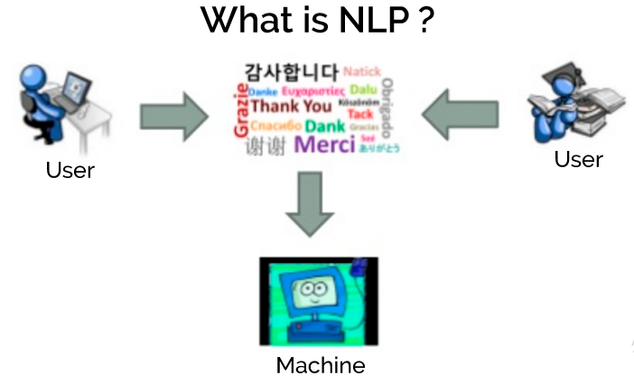

Slide 4
BASIC TERMINOLOGY
NATURAL LANGUAGE PROCESSING (NLP)
Tokenization
Normalization
Stemming eg: running → run.
Lemmatization eg: better → good.
Stop Words eg: The quick brown fox jumps over the lazy dog.

Slide 5
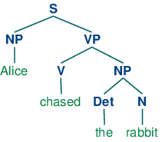
BASIC TERMINOLOGY
Parts-of-speech (POS) Tagging
Bag of Words
n-grams
Regular Expressions
Syntactic Analysis

Slide 6

BASIC TERMINOLOGY
Semantic Analysis
Sentiment Analysis

Slide 7
LIBRARIES FOR NLP USING PYTHON
NLTK
TEXTBLOB
Stanford coreNLP
SpaCy
BeautifulSoup

Slide 8
APPLICATION
Machine Translation
Fighting Spam
Information Extraction
Summarization
Question Answering

